Slide 1
3rd INTERNATIONAL CONFERENCE ON EMERGING TECHNOLOGIES IN DATA MINING AND INFORMATION SECURITY IEMIS 2022 SPRINGER
Covid-19 prediction analysis using machine
learning approach(Paper id-144)
Computer Science and Engineering Department
Future Institute of Engineering and Management, Kolkata 700150
Prithish Sarkar(Presenter), Ahana Mittra, Aritra Das Chowdhury
Under the guidance of Prof Monoj Kumar Sur

Slide 2
INTRODUCTION

Slide 3
INTRODUCTION
In early December of 2019, a novel coronavirus was discovered in Wuhan province of the People’s Republic of China[1].
Within a short span of time, the disease spread from China to over 100 countries, resulting in a global pandemic.
The pandemic put stress on medical infrastructure and resources. Prompt and effective clinical decision of medical resources is decisive to handle the situation.
The RT-PCR which is the test confirming covid-19 infection is restricted by the shortfall of reagents, time taking , high cost and need for dedicated labs with trained pathologies.
Many developing countries faced shortage of RT-PCR kits.

Slide 4
OBJECTIVE
With the sudden rise in infections, there were large queues for covid-19 tests stressing the medical laboratories with many laboratories facing shortage of testing kits.
There is a requirement for cost effective and quick diagnostic model to determine positive and negative cases.
This paper aims to analyze different algorithm and predict covid-19 infection in an individual person from initial symptoms and information.
Previous works had the limitations and future scope of comparing and bringing out the best suited algorithm for the prediction.

Slide 5
Introduction to machine learning for prediction
Alternative to RT-PCR test can be Chest CT-Scan[2] and X-rays, still they cannot always be used for screening patients because of high cost and low availability of device.
The artificial intelligence (AI) and machine learning models have been widely used and carried out trials on various healthcare sector.
Situation demands the need of using such techniques to identify, predict and help in prioritizing RT-PCR test with speed and eﬀiciency

Slide 6
DATASET
The covid-19 infection had sign and symptoms of cough[3],fever[4] and shortness of breath[5]. Along with these symptoms, total 5 symptoms and three basic information have been used.
The Israeli Ministry of Health published data of every individual who tested Covid-19 by RT-PCR test[6]. The dataset is available to be accessed.

Slide 7
DATASET USED
Features | Status | Total No. Of Samples | Total
Cough | Yes(1) | 2631258 | 2742596
 | No(0) | 111338
Fever | Yes(1) | 2645600 | 2742596
 | No(0) | 96996
Sore throat | Yes(1) | 2712512 | 2742596
 | No(0) | 30084
Shortness of breath | Yes(1) | 2731579 | 2742596
 | No(0) | 11017
Headache | Yes(1) | 2682655 | 2742596
 | No(0) | 59941
Age 60 and above | Yes(1) | 1908553 | 2287838
 | No(0) | 286399
 | Nan | 547644
Gender | Female(1) | 1278266 | 2742596
 | Male(0) | 1371444
 | Nan | 92886
Test Indication | Other (0) | 2547559 | 236255
 | Contact With Confirmed (1) | 170742
 | Abroad (2) | 24295
Features:
Cough
Fever
Sore throat
Shortness of Breath
Headache
Age( >= 60)
Test Indication
Gender

Slide 8
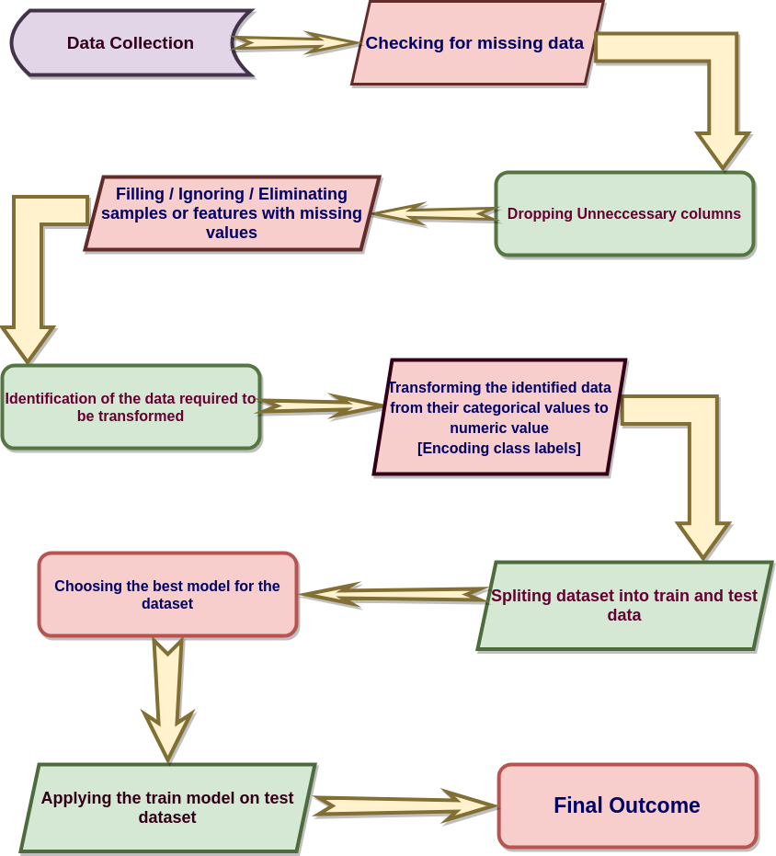
FLOWCHART OF THE PROPOSED COVID-19 PREDICTION APPROACH

Slide 9
METHODOLOGY
Dataset Collection
Checking For Missing Data and Null values
Dropping Unnecessary information, like date is removed
Eliminating Features having Missing or Null values
Features with categorical value is identified
Identified data is represented into numerical values
Resultant feature file contained cough,fever,shortness of breath, headache and sore throat, along with basic information of age and gender.
Splitting Data into Training and Testing Set
Model Implementation
The predictions of different model is analysed

Slide 10
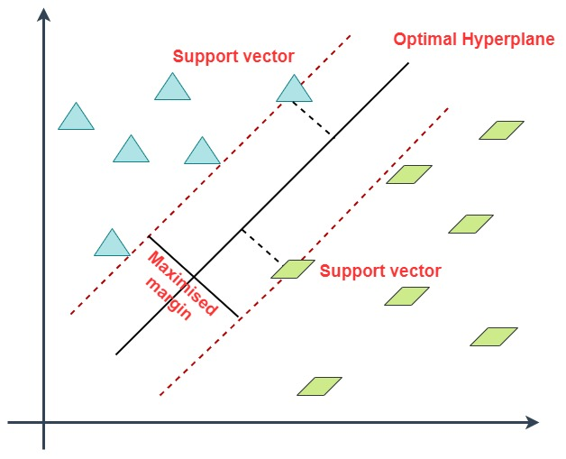
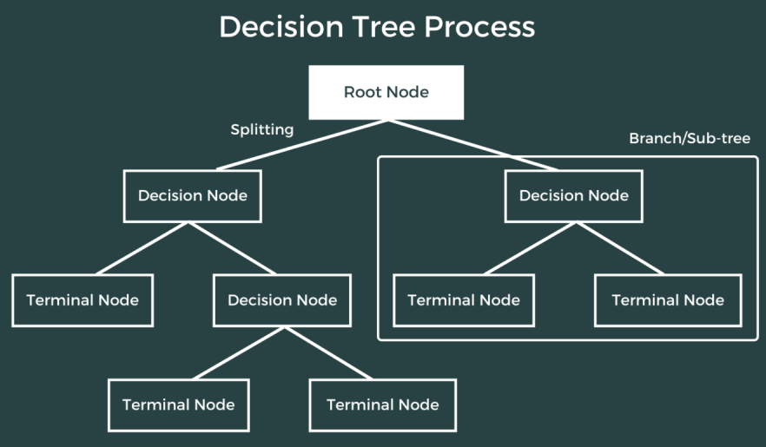
MACHINE LEARNING ALGORITHMS APPLIED
Support Vector Machine(SVM)
Decision Tree Classifier

Slide 11
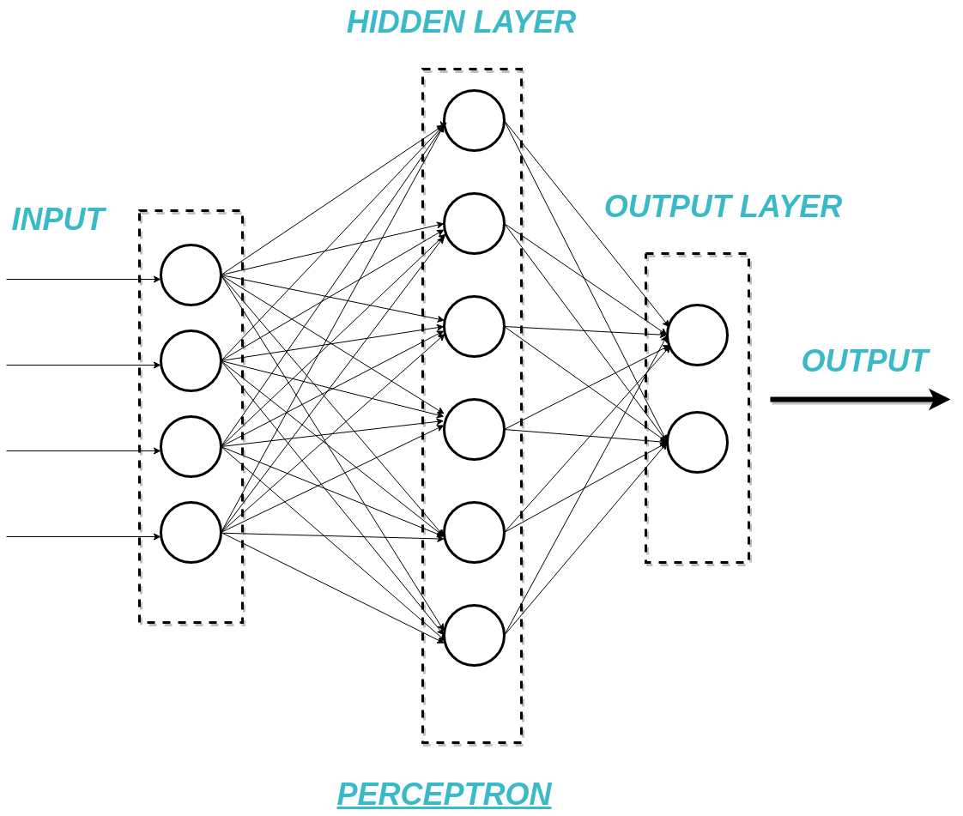
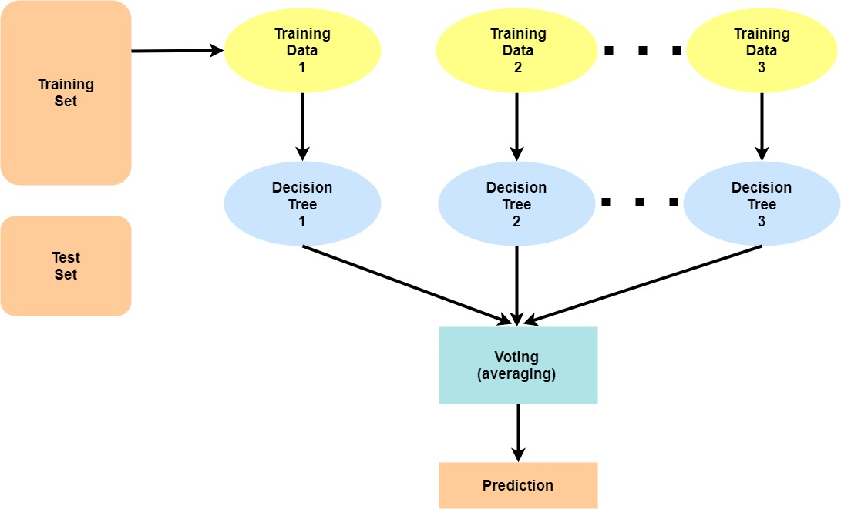
Random Forest
Multi-layer Perceptron Classifier

Slide 12
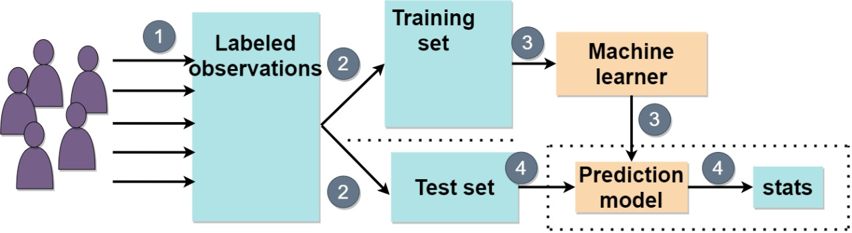
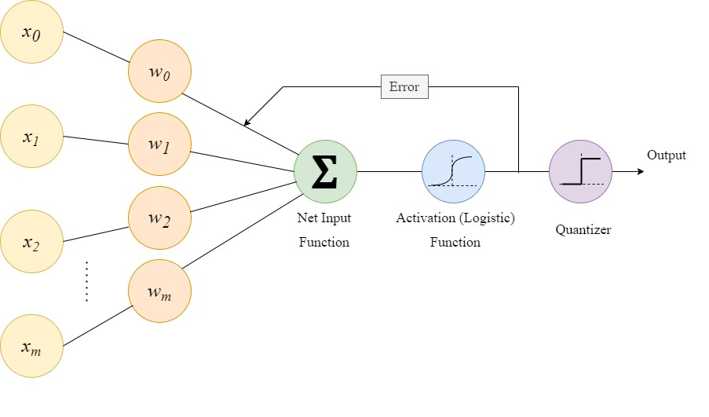
Gradient Boosting Classifier
Logistic Regression

Slide 13

Result And Discussion

Slide 14
Result
Model Name | Precision | Recall | Accuracy
Support Vector Machine | 0.86 | 0.90 | 89.60
Random Forest | 0.88 | 0.91 | 90.28
Decision Tree | 0.90 | 0.92 | 91.93
Multi-Layer Perceptron Classifier | 0.91 | 0.92 | 92.49
Gradient Boosting Classifier | 0.91 | 0.93 | 92.79
Logistic Regression | 0.90 | 0.93 | 92.94
The six mentioned machine learning algorithms are applied on the previously stated feature set to generate training model. The test set is then fed to corresponding built models to find the prediction and thereby finding accuracy, precision and recall.

Slide 15
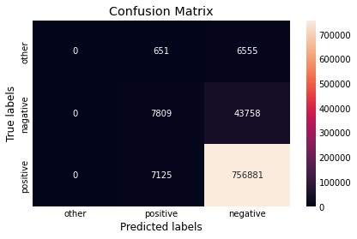
OBSERVATION
It was observed that Logistic Regression provided the best outcome over other models. It achieved an accuracy of 92.94% The confusion matrix is attached.

Slide 16
CONCLUSION AND DISCUSSION
The newly recognized infection, covid-19 has become a major threat to many countries in terms of health, security as well as financial instability.
It brings a challenge to get readily available data and information.
The RT-PCR test whose alternative is using CT and X-Ray images. These tests are not very suitable due to lack of available devices, high cost, time consuming and radiation doses.

Slide 17
CONTINUATION
All these factors led to a long queue of patients awaiting test. Resulting in increased rate of infection.
With a solution to screen the patients on basis of priority of covid test, we propose few models to predict the covid-19 positive and negative cases using machine learning classification on few clinical features.
The models were validated and evaluated using confusion matrix, accuracy, precision, recall, F1 and support. The logistic regression outperformed all other models with an accuracy of 92.94%. Every other models performed well with achieving an accuracy of 89+%.

Slide 18
CONTINUATION
The dataset was limited to one country, Israel. The outbreak of covid-19 may not be repeated everywhere[7] as reported and observed by many.
Hence, our work is limited to a particular country with unavailability of data from other countries.
For further research, applying the models on data of different country and on a larger data with feature as image would enhance the standard and accuracy of the prediction.

Slide 19
REFERENCE
Zhu N et al (2020) A novel coronavirus from patients with pneumonia in China, 2019. N Engl J Med. https://doi.org/10.1056/NEJMoa2001017
Majidi, H. and Niksolat, F., 2020. Chest CT in patients suspected of COVID-19 infection: A reliable alternative for RT-PCR. The American Journal of Emergency Medicine, 38(12), pp.2730-2732.
Lu, R., Zhao, X., Li, J., Niu, P., Yang, B., Wu, H., Wang, W., Song, H., Huang, B., Zhu, N. and Bi, Y., 2020. Genomic characterisation and epidemiology of 2019 novel coronavirus: implications for virus origins and receptor binding. The lancet, 395(10224), pp.565-574.
Chan, J.F.W., Yuan, S., Kok, K.H., To, K.K.W., Chu, H., Yang, J., Xing, F., Liu, J., Yip, C.C.Y., Poon, R.W.S. and Tsoi, H.W., 2020. A familial cluster of pneumonia associated with the 2019 novel coronavirus indicating person-to-person transmission: a study of a family cluster. The lancet, 395(10223), pp.514-523.
Shi, Y., Yi, Y., Li, P., Kuang, T., Li, L., Dong, M., Ma, Q. and Cao, C., 2003. Diagnosis of severe acute respiratory syndrome (SARS) by detection of SARS coronavirus nucleocapsid antibodies in an antigen-capturing enzyme-linked immunosorbent assay. Journal of clinical microbiology, 41(12), pp.5781-5782.
COVID-19-Government Data. https://data.gov.il/dataset/covid-19 (2020).
Remuzzi, A. and Remuzzi, G., 2020. COVID-19 and Italy: what next?. The lancet, 395(10231), pp.1225-1228

Slide 20

Thank You

